Slide 1



PA 604
The Ethics of Social Research
Professor Burrel Vann Jr

Slide 2

Why do we need ethics in social research?

Slide 3
RISK: ANONYMITY & CONFIDENTIALITY
Laud Humphreys - The Tearoom Trade
Ethical Controversies
PSYCHOLOGICAL HARM: OBEDIENCE
Stanley Milgram
PSYCHOLOGICAL HARM: POWER & ROLE CONFORMITY
Philip Zimbardo

Slide 4

The Tearoom Trade
LAUD HUMPHREYS
Studied gay sexual activities in public restrooms in parks
Volunteered to become “watchqueen”/police lookout while men engaged in sexual activity
Wanted to know "who" engaged in gay public sex and why
IGNORING ANONYMITY AND CONFIDENTIALITY
ETHICAL PROBLEMS
Collected license numbers of participants' cars
Linked plates to addresses and met them at their homes to interview/confront them

Slide 5
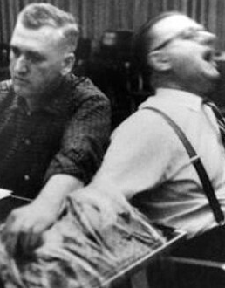
Shockingly Obedient
STANLEY MILGRAM
Participants imitated a laboratory-based World War II controversy
Participants were assigned job of “teacher” – to teach a list of words to the “student” (who worked with Milgram).
If the student got the word wrong, the teacher would administer increasing levels of shocks to the student, up to and beyond fatal levels
PSYCHOLOGICAL HARM
ETHICAL PROBLEMS
Deceived teachers into believing they killed someone
Forced participants through intimidation, stress, yelling, to keep increasing levels of shock, against their will (in most cases)
Notes:
https://www.youtube.com/watch?v=fCVlI-_4GZQ&feature=youtu.be

Slide 6
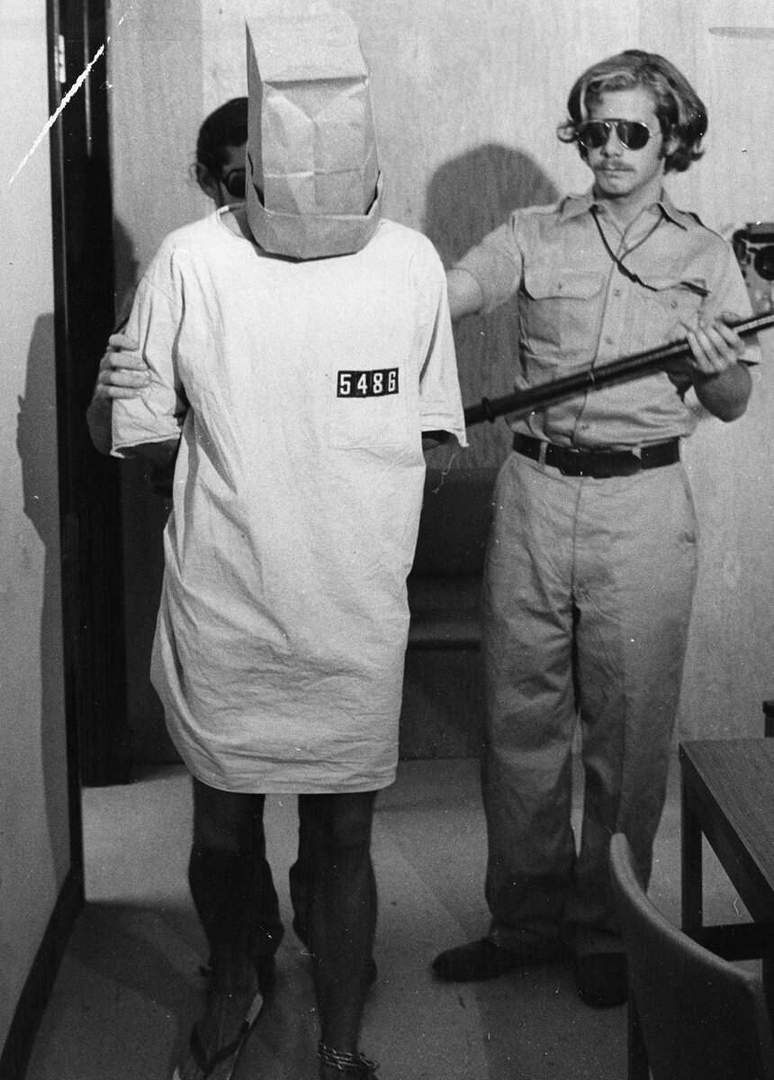
Stanford Prison Experiment
PHILIP ZIMBARDO
Wanted to understand if authoritarian, torturous, brutal, and sadistic behavior was dispositional (personal characteristics) or situational (environmental).
Randomly assigned Stanford students to "guard" or "prisoner" roles
Guards immediately accepted authoritarian role, treated prisoners
PSYCHOLOGICAL HARM
ETHICAL PROBLEMS
After six days, experiment abandoned as "guards" began physically and psychologically torturing
Zimbardo didn't allow early exit, participants not debriefed, no consent given
Lasting psychological trauma
Notes:
https://www.youtube.com/watch?v=oAX9b7agT9o

Slide 7

Ethical Standards in Social Research
Rules developed and designed to help protect human research participants (subjects) from harm and risk

Slide 8

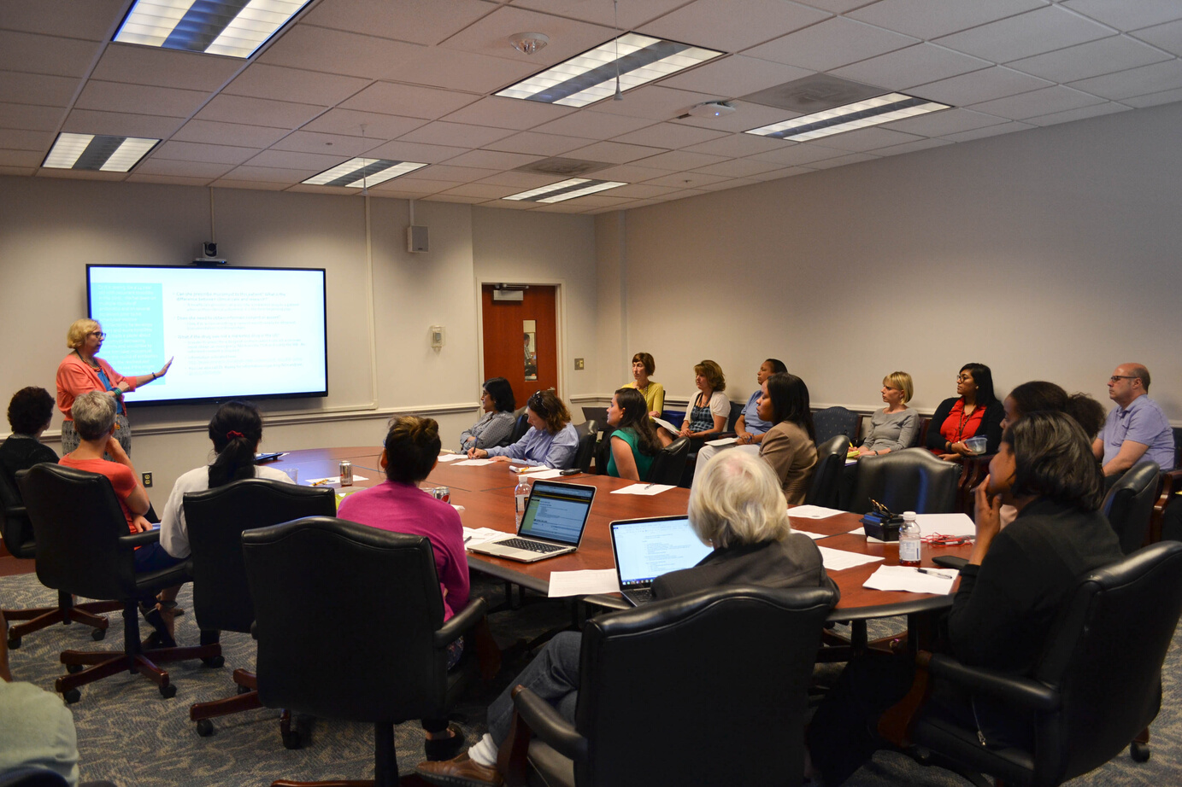
Who sets the ethical standards?
PROFESSIONAL ORGANIZATIONS
Organizations for each discipline set standards for their conducting human subjects research in their discipline
INSTITUTIONAL REVIEW BOARDS (IRB)
Panel of experts at each institution that enforces these rules
Notes:
https://www.asc41.com/ASC_Official_Docs/ASC_Code_of_Ethics.pdf
https://www.asanet.org/code-ethics
APA (Planning): https://www.planning.org/ethics/
APA (Psychology): https://www.apa.org/ethics
ASPA (Public Administration): https://www.aspanet.org/ASPA/Code-of-Ethics/ASPA/Code-of-Ethics/Code-of-Ethics.aspx?hkey=5b8f046b-dcbd-416d-87cd-0b8fcfacb5e7

Slide 9
Institutional Review Board
ENSURING RESEARCHERS FOLLOW ETHICAL GUIDELINES FOR HUMAN SUBJECTS
Who? What?
Why?
A panel of faculty/experts who review all research proposals involving human participants
To guarantee participants’ rights will be protected
To ensure that the risks faced by human participants in research are minimal
Where?
When?
Every institution that is federally-funded and/or conducts research must have an IRB.
SDSU IRB
Usually meets once per month
Notes:
https://research.sdsu.edu/research_affairs/human_subjects

Slide 10
Institutional Review Board
ENSURING RESEARCHERS FOLLOW ETHICAL GUIDELINES FOR HUMAN SUBJECTS
What ethical assurances does IRB want you to provide to your participants?
VOLUNTARY PARTICIPATION
USE OF DECEPTION
NO HARM
ANONYMITY
CONFIDENTIALITY
A guarantee that if participants misled in order to obtain information in a covert way, they are debriefed about deception after the conclusion of the study
Needs strong scientific justification.
No one should be forced to participate
People being researched should never be injured (physically, mentally, emotionally, socially, psychologically)
A guarantee that neither the researchers nor the readers of the findings can identify a given response with a given participant
A guarantee that if the researcher can identify a given person’s responses, they promise not to do so publicly
unless subpoenaed or under oath
Notes:
In certain research, respondents/participants are asked to face parts of themselves they are uncomfortable with (e.g. talking about past deviant behavior, unpopular attitudes/racism, or personal characteristics they believe to be demeaning, or can break an already fragile self-esteem)
If a research project is going to have any of these potential harms, you must have strong scientific grounds for doing it.
Deception
Lying about research purposes is coming in laboratory experiments (Solomon Asche Experiment on conformity and lines).
Debriefing helps researchers discover any problems generated by the research process so they can be corrected.

Slide 11
Institutional Review Board
ENSURING RESEARCHERS FOLLOW ETHICAL GUIDELINES FOR HUMAN SUBJECTS
How do you inform participants that you are providing them with these assurances?
INFORMED CONSENT
A legal form that participants must sign to participate
Acknowledges that their voluntary participation in a research project is based on their full understanding of the possible harms and risks involved
Outlines researchers steps to ensure anonymity and confidentiality
Describes how much time the study will take
Lists contact information for researchers for follow-up
Notes:
In certain research, respondents/participants are asked to face parts of themselves they are uncomfortable with (e.g. talking about past deviant behavior, unpopular attitudes/racism, or personal characteristics they believe to be demeaning, or can break an already fragile self-esteem)
If a research project is going to have any of these potential harms, you must have strong scientific grounds for doing it.
Deception
Lying about research purposes is coming in laboratory experiments (Solomon Asche Experiment on conformity and lines).
Debriefing helps researchers discover any problems generated by the research process so they can be corrected.

Slide 12

Which projects require IRB approval?
ALL PROJECTS USING DIRECT OBSERVATIONS OF HUMAN SUBJECTS
PRIMARY DATA COLLECTION AND ANALYSIS
Interviews
Surveys
Ethnography
Experiment
Participant Observation

Slide 13
Which projects do not require IRB approval?
ALL PROJECTS NOT USING DIRECT OBSERVATIONS OF HUMAN SUBJECTS
SECONDARY DATA ANALYSIS
Content Analysis
Text Analysis
Analysis of Previously Administered Surveys
Census
Publicly-Available Data (where participants remain anonymous)

Slide 14
Steps to jumpstart your ethical research
PRIMARY
SECONDARY
RESEARCH QUESTIONS
RESEARCH QUESTIONS
Develop research questions about the relationship between variables
Develop research questions about the relationship between variables
MATERIALS & PROCEDURES
MATERIALS & PROCEDURES
Develop materials and procedures for answering the research question (e.g. questionnaire, interview/topic guide, manipulation conditions) and informed consent document
Identify data sets that include variables that can be used to answer the research question
IRB
Submit an application to the IRB at your institution, outlining the procedures to answer the human subjects research question, include materials as well as the informed consent form. Wait for approval
BEGIN DATA COLLECTION
BEGIN DATA COLLECTION
Only after IRB has approved the research protocol can the researcher begin data collection
Gather/merge data sets. Caution: Some data sets may require researchers to request special access

